Slide 1
Corporate Engagement & Partnerships

Slide 2
Assistant Professor of Management, Columbia
PhD, Management, UCLA
Expertise
  Corporate social responsibility
  Sustainability strategy
  Employee motivation
Other Synergistic Experience
  Leadership Team, Academy of Management’s Strategy Division
  Leadership Team, Strategic Management Society’s Stakeholder Strategy Group
  Board Member, Alliance for Research on Corporate Sustainability
2

Slide 3
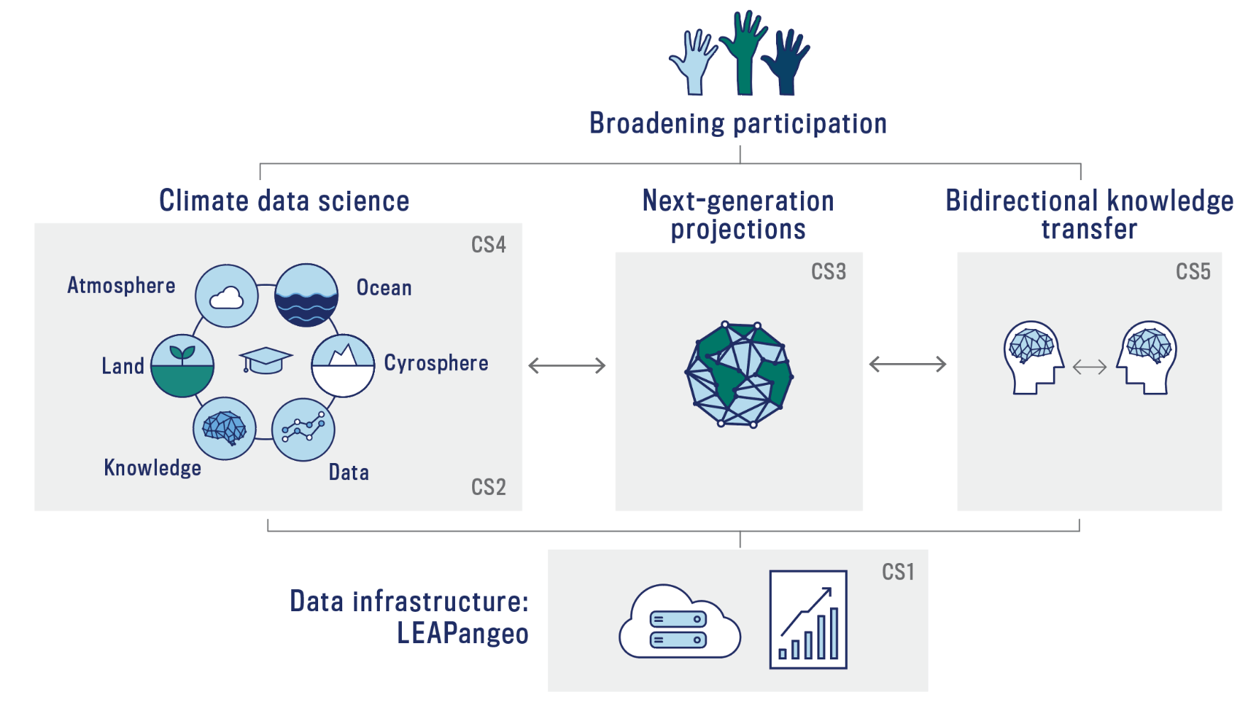
Our Roadmap
LEAP forward in the reliability, utility, and reach of climate projections through synergistic innovations in data science and climate science.
3

Slide 4
My Presentation Will Explain:
Why + how LEAP promotes bidirectional knowledge exchange with corporate stakeholders
Role + integration of corporate + information-dissemination partners
4

Slide 5
The Private Sector is Important for LEAP
Corporations either exacerbate, or help to mitigate, climate change
Only if knowledge outputs are relevant to + usable by corporate audiences will LEAP have an impact through the private sector
5

Slide 6

Content + Format of Knowledge Outputs Will Vary to Ensure Relevance for a Range of Corporate Audiences
LEAP Climate
Information Portal
Granularity of Knowledge Output of Relevance
High
Low
Raw datasets + tutorials
Aggregated data in exec-friendly format
Executive summaries of findings “translated” for a corporate audience
Research-informed tools for communication + design of initiatives
6

Slide 7
LEAP Will Generate Research-Informed Tools for Communication + Design of Sustainability Initiatives
Why Important?
What is Missing?
Companies either exacerbate, or help to mitigate climate change
Challenge: conflicting goals
Research on “doing well by doing good” inconclusive
Need to understand mechanisms through which sustainability-oriented initiatives can influence company stakeholders *
Need to understand how design and communication of initiatives can influence stakeholders**
Need for causal studies***
Opportunity for LEAP
Create, aggregate + “translate” relevant research
7
  *Burbano et al., 2018. ** Delmas + Pecovic, 2013; Asensio + Delmas, 2014. ***Burbano, 2016, 2019, 2020

Slide 8
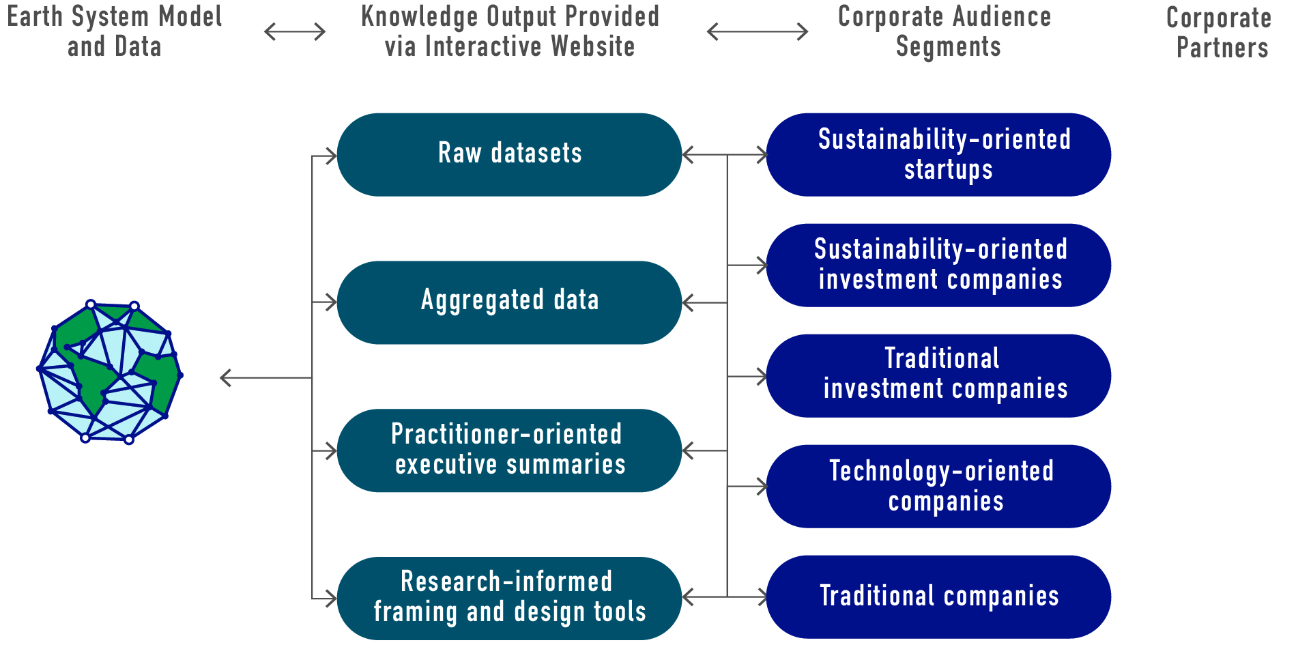
LEAP Adjusts Knowledge Outputs to Ensure Relevance to a Range of Corporate Audiences
        Corporate Audience Segments
        Earth System Models + LEAPAngeo
        LEAP Climate Information Portal
8

Slide 9






LEAP’s Corporate Partners are Representative of this Range of Corporate Audience Segments
        Corporate Audience Segments
        Earth System Models + LEAPAngeo
        LEAP Climate Information Portal
        Corporate Partners
9

Slide 10
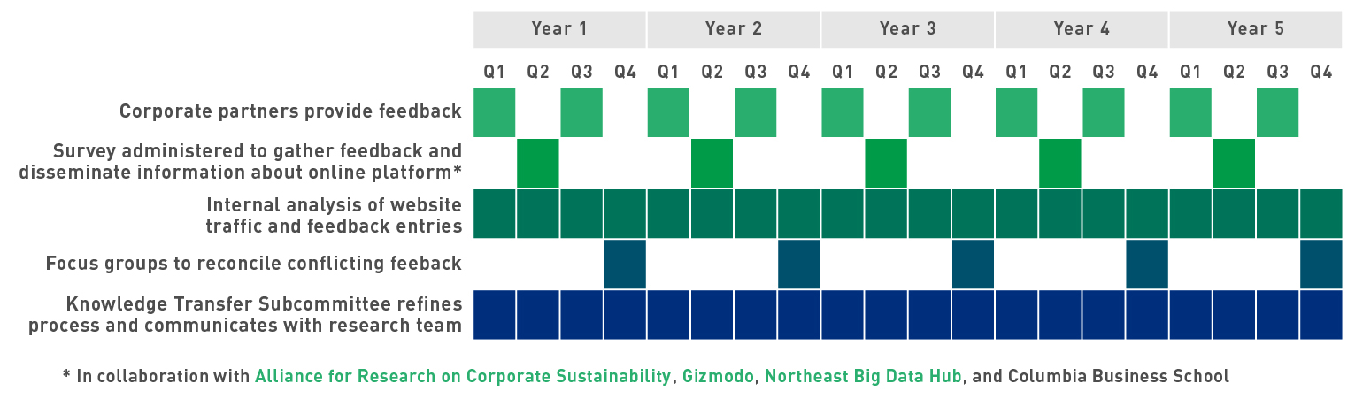




LEAP’s Process for Corporate Engagement
10

Slide 11
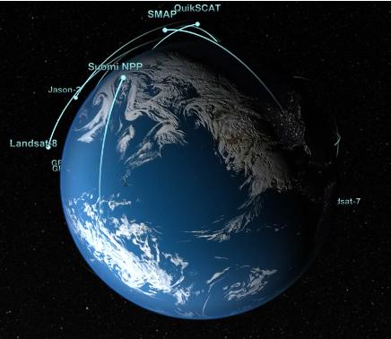


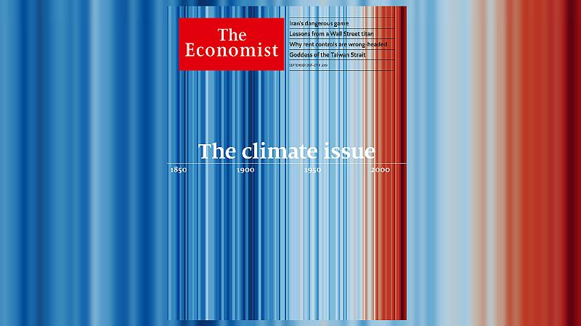
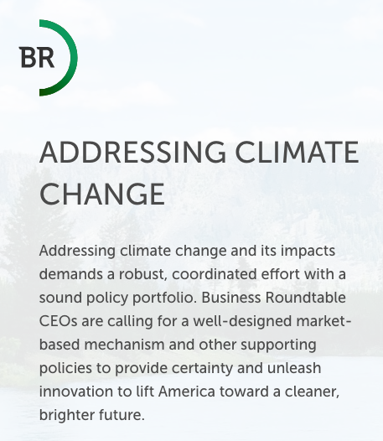
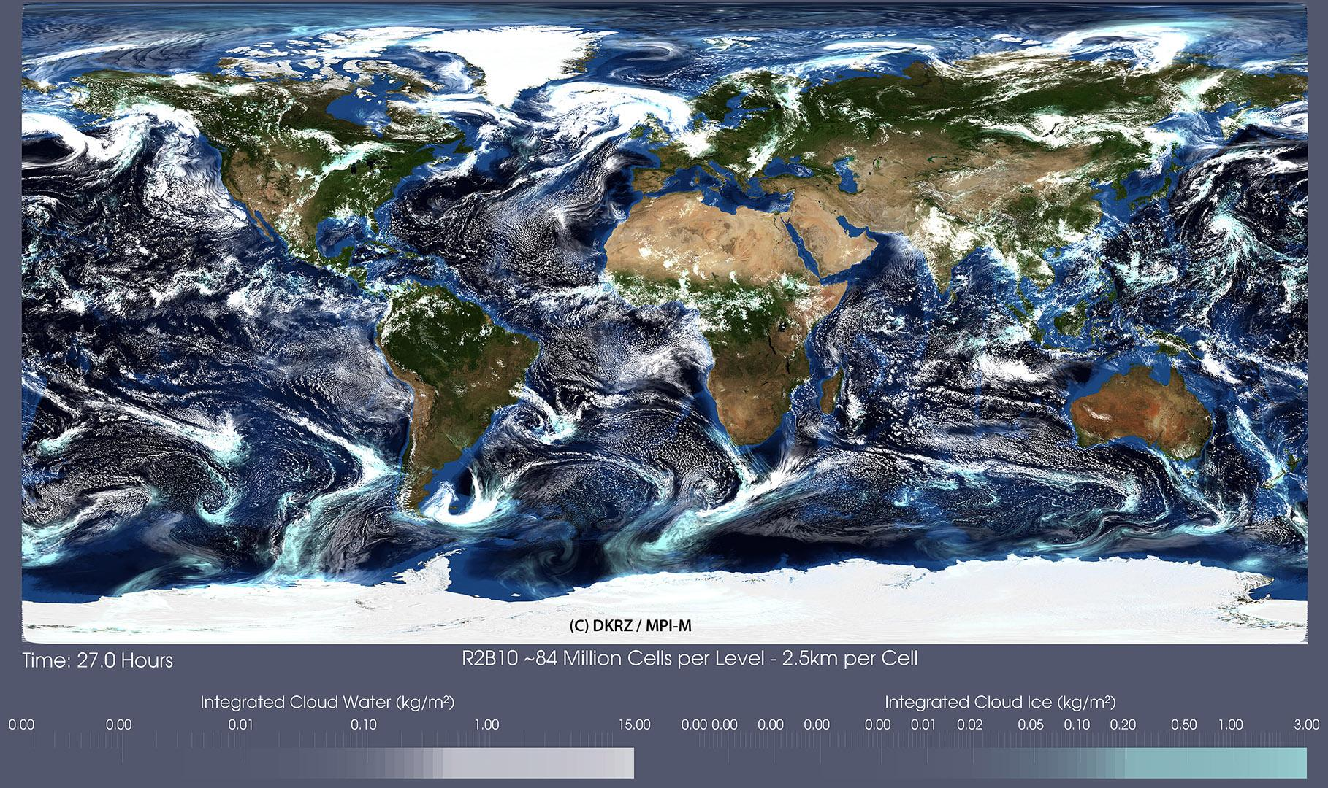
Today is a Unique Moment of Opportunity for Corporate Engagement on Climate Change
Public Debate on Climate Change + Diversity
High-Resolution Process-Resolving Simulations
Private Sector New Ally for Change
Massive Data
from Earth Observations
Progress in Machine Learning

Slide 12
Increasing Climate Models’ Utility + Reach Requires Corporate Stakeholder Engagement + Segmentation + Research
LEAP’s online platform must be a key “go-to” source for data, information + practitioner-oriented tools on climate issues
  Annual evaluation based on survey responses
This will facilitate private sector consideration of + adaptation to climate realities
12

Slide 13
Questions?

